Slide 1
Data Communications for a Global Environment
Lecture 4

Slide 2
Application Layer Examples
Data Communications for a Global Environment
Web Browser
E-mail
File Transfer
Videoconferencing
Instant Messaging

Slide 3
Web Browser
Data Communications for a Global Environment
Web began with two innovative ideas:
Hypertext
A document containing links to other documents
Uniform Resource Locators (URLs)
A formal way of identifying links to other documents
Invention of WWW (1989)
By Tim Berners-Lee at CERN in Switzerland
First graphical browser, Mosaic, (1993)
By Marc Andressen at NCSA in USA; later founded Netscape
CERN - Conseil Européen pour la Rechèrche Nucléaire (Berners-Lee, T. (2000) Weaving the Web. New York: HarperCollins. P. 4)
NCSA - National Center for Supercomputing Applications

Slide 4
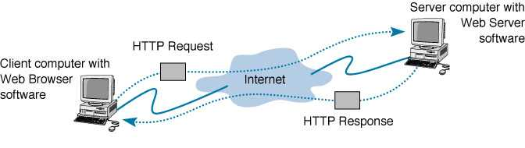
How the Web Works
Data Communications for a Global Environment
Main Web communications protocol:
HTTP: Hypertext Transfer Protocol
Server Computer
HTTP Request
thru TCP stack
Client Computer
HTTP Response
thru TCP stack
A request-response cycle: includes multiple steps since web pages often contain embedded files, such as graphics, each requiring a separate response.
Clicking on a hyperlink or typing a URL into a browser starts a request-response cycle

Slide 5
HTTP Characteristics
Data Communications for a Global Environment
HTTP is a networking protocol for distributed, collaborative,
hypermedia information systems.
HTTP functions as a request-response protocol in the client-server
computing model.

Slide 6
HTTP/1.1 Request Message
Data Communications for a Global Environment
Request line
(command, URL, HTTP version number)
required
(If the user types in the URL by themselves, then the referring page is blank.)
Request header(s)
(Host, date, and the referring page )
Only Host
Is required
Request body
(information sent to the server,
such as from a form)
optional
RFC 2616 from working group of IETF has 1.1 spec

Slide 7
Example of Request Commands
Data Communications for a Global Environment
HEAD
Asks for the response identical to the one that would correspond to a GET request, but without the response body.
This is useful for retrieving meta-information written in response headers, without having to transport the entire content.
GET
Requests a representation of the specified resource. Note that GET should not be used for operations that cause
side-effects, such as using it for taking actions in web applications. One reason for this is that GET may be used
arbitrarily by robots or crawlers, which should not need to consider the side effects that a request should cause.
POST
Submits data to be processed (e.g., from an HTML form) to the identified resource. The data is included in the body
of the request. This may result in the creation of a new resource or the updates of existing resources or both.
PUT
Uploads a representation of the specified resource.
DELETE
Deletes the specified resource.
TRACE
Echoes back the received request, so that a client can see what (if any) changes or additions have been made by
intermediate servers.
OPTIONS
Returns the HTTP methods that the server supports for specified URL. This can be used to check the functionality
of a web server by requesting '*' instead of a specific resource.
CONNECT
Converts the request connection to a transparent TCP/IP tunnel, usually to facilitate SSL-encrypted communication
(HTTPS) through an unencrypted HTTP proxy.
PATCH
Is used to apply partial modifications to a resource.

Slide 8
Data Communications for a Global Environment
Example of an HTTP Request
GET /default.htm HTTP/1.1\r\n
Host: rhynoruv\r\n
Accept: */*\r\n
\r\n
Request Line
Mandatory header line
Optional Header Info
Optional body Info
Note that this HTTP Request message has no “Body” part.

Slide 9
HTTP/1.1 Response Message
Data Communications for a Global Environment
Response status
(http version number, status code, reason)
required
Response header
(Date, information on the server,
URL of the page retrieved, format used )
Date is mandatory
Response body
(requested web page)
optional

Slide 10
Data Communications for a Global Environment
Response line
Mandatory
HTTP/1.1 200 OK\r\n
Content-Length: 50\r\n
Content-Type: text/html\r\n
Last-Modified: Sun, 20 Oct 2002 22:52:16 GMT\r\n
Accept-Ranges: bytes\r\n
ETag: "255591568b78c21:5cd"\r\n
Server: Microsoft-IIS/6.0\r\n
MicrosoftOfficeWebServer: 5.0_Pub\r\n
X-Powered-By: ASP.NET\r\n
Date: Sun, 20 Oct 2002 22:52:35 GMT\r\n
\r\n
<HTML>\r\n
<BODY>\r\n
\r\n
Hello World.\r\n
\r\n
</BODY>\r\n
</HTML>
Response Header
Mandatory
Response Body

Slide 11
HTTP Response Status Codes
Data Communications for a Global Environment
Success 2XX
eg: OK 200, Created 201,
Redirection 3XX
eg: Moved 301
Error 4XX, 5XX
eg: Bad request 400, Unauthorized 401, Not Found 404,
Internal Error 500, Service temporarily overloaded 502

Slide 12
HTML - Hypertext Markup Language
Data Communications for a Global Environment
A protocol used to format Web pages
Also developed at CERN (initially for text files)
Tags are embedded in HTML documents
include information on how to format the file
Extensions to HTML needed to format multimedia files
XML - Extensible Markup Language
A new markup language becoming popular

Slide 13
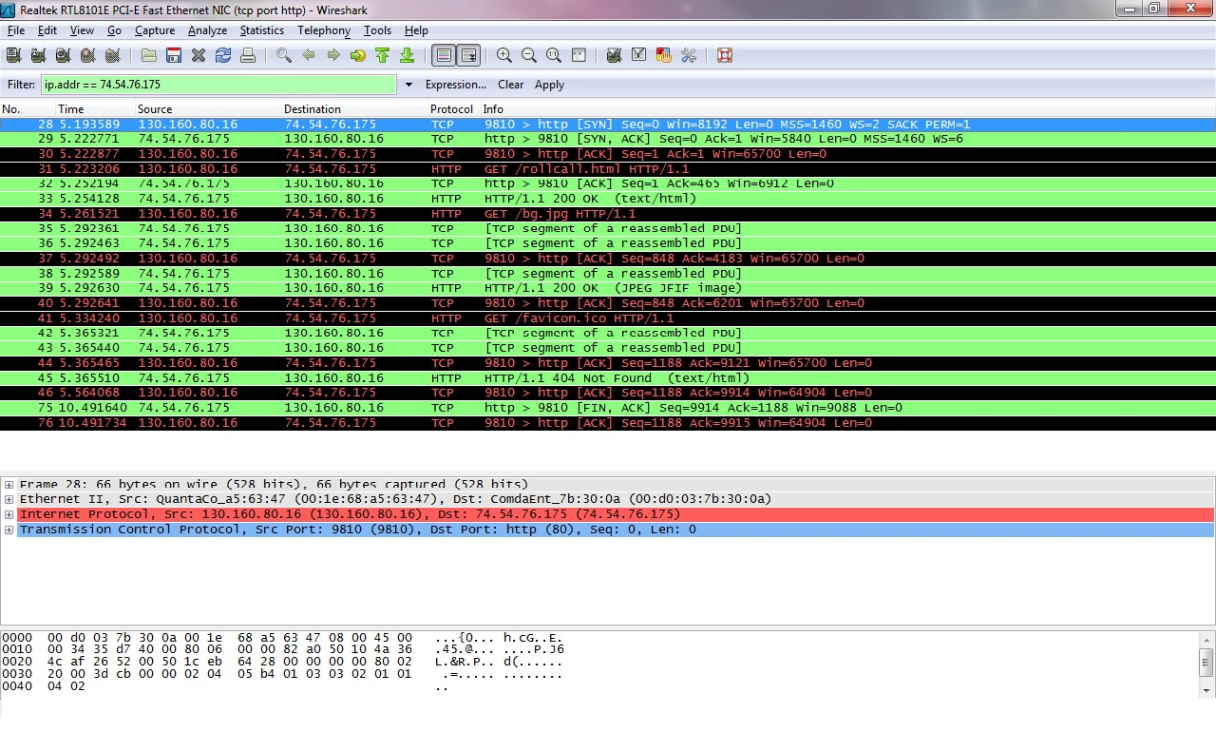
Data Communications for a Global Environment
Lecture 4

Slide 14
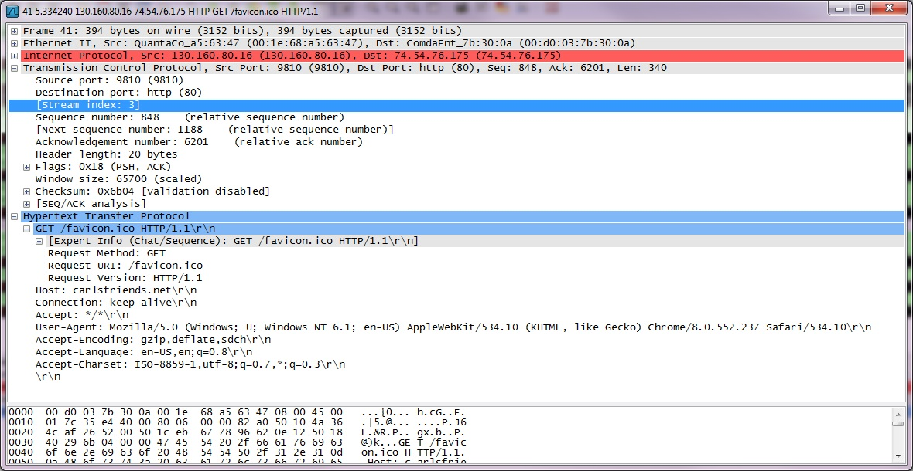
Data Communications for a Global Environment
Lecture 4

Slide 15
E-mail Standards
Data Communications for a Global Environment
SMTP - Simple Mail Transfer Protocol (push protocol)
Main e-mail standard for
Originating user agent and the mail transfer agent
Between mail transfer agents
Originally written to handle only text files
Usually used in two-tier client-server architectures
Post Office Protocol (POP) and Internet Mail Access Protocol (IMAP)
Main protocols used between the receiver user agent and mail transfer agent
Main difference: with IMAP, messages can be left at the server after downloading them to the client

Slide 16
Two-Tier E-mail Architecture
Data Communications for a Global Environment
User agent is another word for an e-mail client application
Run on client computers
Send e-mail to e-mail servers
Download e-mail from mailboxes on those servers
Examples: Eudora, Outlook, Netscape Messenger
Mail transfer agent is another word for the mail server application
Used by e-mail servers
Send e-mail between e-mail servers
Maintain individual mailboxes.

Slide 17
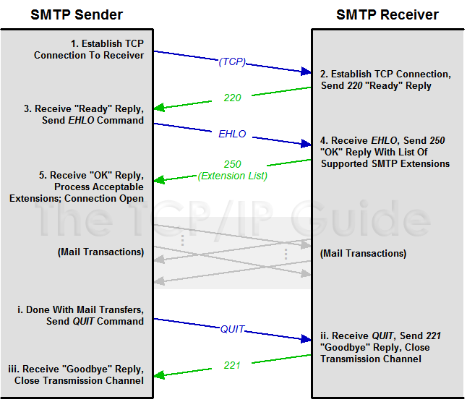
Data Communications for a Global Environment
SMTP Transaction Session Establishment and Termination

Slide 18
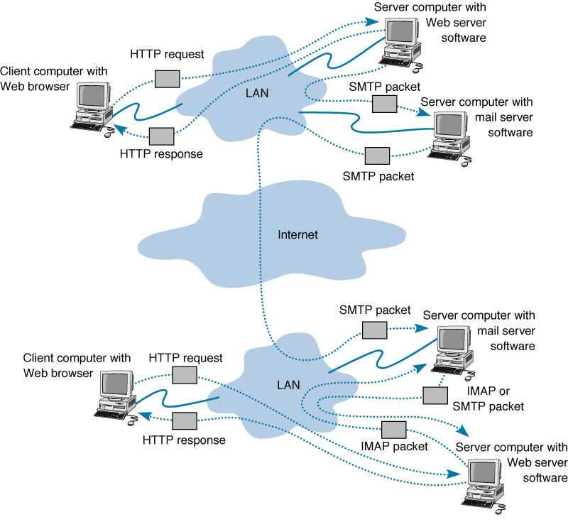
Web-based e-mail
Data Communications for a Global Environment
Server computer with
HTTP request
Web server software
Client computer
With Web
Browser
LAN
SMTP packet
Server computer with
email server software
HTTP response
SMTP packet
Internet
SMTP packet
Server computer with
HTTP request
e-mail server software
Client computer with
Web Browser
LAN
IMAP or
POP packet
HTTP response
IMAP packet
Server computer with
Web server software

Slide 19
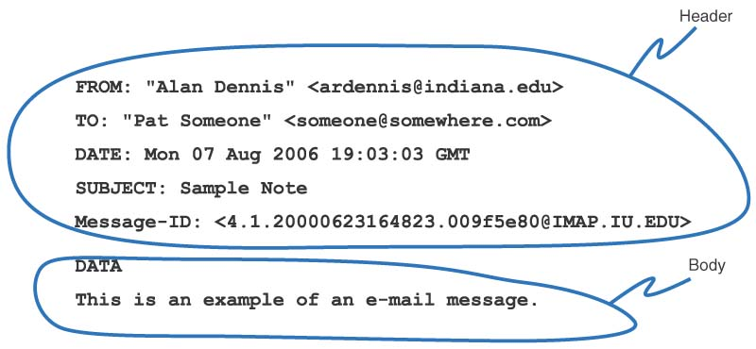
Sample SMTP Message
Data Communications for a Global Environment
Note that this SMTP message has no attachments.

Slide 20
MIME
Data Communications for a Global Environment
Multipurpose Internet Mail Extension
A graphics capable mail transfer agent protocol (to send graphical information in addition to text)
SMPT was designed years ago for text transfer only
MIME software is included as part of an e-mail client
Translates graphical information into text allowing the graphic to be sent as part of an SMTP message (as a special attachment)
Receiver’s e-mail client then translates the MIME attachment from text back into graphical format

Slide 21
Electronic Mailing Lists/eg: Listserv
Data Communications for a Global Environment
Mailing lists of users who join to discuss some special topic (e.g., cooking, typing, networking)
Some permit any member to post messages, some are more restricted
Parts of listserv
Listserv Processor
Process commands ( subscriptions, etc,)
Listserv Mailer
Receive a message and resend it to everyone
To subscribe
Send an email to Listserv processor (address of the processor is different than the address of mailer)

Slide 22
File Transfer Protocol (FTP)
Data Communications for a Global Environment
Enables sending and receiving files over the Internet
Requires an application program on the client computer and a FTP server program on a server
Commonly used today for uploading web pages
Many packages available using FTP
WS-FTP (a graphical FTP software)
FTP sites
Closed sites
Requires account name and password
Anonymous sites
Account name: anonymous; password: email address

Slide 23
Telnet
Data Communications for a Global Environment
Allows one computer to log into another computer
Remote login enabling full control of the host
Requires an application program on the client computer and a Telnet server program on the server
Client program emulates a “dumb” terminal off the server
Many packages available conforming Telnet
EWAN
Requires account name and password
Anonymous sites similar to FTP approach
Account name: anonymous; password: email address

Slide 24
Data Communications for a Global Environment
Internet Protocol Suite
Application Layer
BGP · DHCP · DNS · FTP · HTTP · IMAP · IRC · LDAP · MGCP · NNTP · NTP · POP · RIP · RPC · RTP · SIP · SMTP · SNMP · SSH · Telnet · TLS/SSL · XMPP · (more)
Transport Layer
TCP · UDP · DCCP · SCTP · RSVP · ECN · (more)
Internet Layer
IP (IPv4, IPv6) · ICMP · ICMPv6 · IGMP · IPsec · (more)
Link Layer
ARP/InARP · NDP · OSPF · Tunnels (L2TP) · PPP · Media Access Control (Ethernet, DSL, ISDN, FDDI) · (more)

Slide 25
Instant Messaging (IM)
Data Communications for a Global Environment
A client-server program that allows real-time typed messages to be exchanged
Client needs an IM client software
Server needs an IM server package
Some types allow voice and video packets to be sent
Like a telephone
Examples include AOL and ICQ
Two step process:
Telling IM server that you are online
Chatting

Slide 26
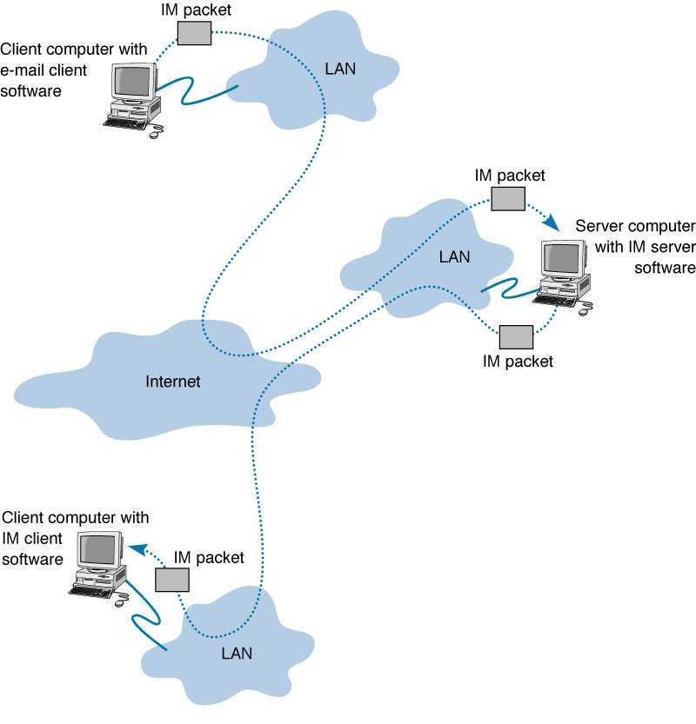
How Instant Messaging Works
Data Communications for a Global Environment
Client computer with
IM packet
When the sender types in text, the IM client sends the text in a packet to the IM server which relays it to the receiver.
e-mail client software
LAN
IM packet
Server computer with
Sender sends a request to the IM server telling it that sender is online. If a friend connects, the IM server sends a packet to sender’s IM client and vice versa.
LAN
with IM server software
Internet
IM packet
Client computer with
If a chat session has more than two clients, multiple packets are sent by the IM server. IM servers can also relay information to other IM servers.
IM client software
IM packet
LAN

Slide 27
Videoconferencing
Data Communications for a Global Environment
Provides real time transmission of video and audio signals between two or more locations
Allows people to meet at the same time in different locations
Saves money and time by not having to move people around
Typically involves matched special purpose rooms with cameras and displays
Desktop videoconferencing
Low cost application linking small video cameras and microphones together over the Internet
No need for special rooms
Example: Net Meeting software on clients communicating through a common videoconference server

Slide 28
Videoconferencing Standards
Data Communications for a Global Environment
Proprietary early systems
Common standards in use today
H.320
Designed for room-to-room videoconferencing over high-speed phone lines
H.323
Family of standards designed for desktop videoconferencing and just simple audio conferencing over Internet
MPEG-2
Designed for faster connections such as LAN or privately owned WANs

Slide 29
Webcasting
Data Communications for a Global Environment
Special type of uni-directional videoconferencing
Content is sent from the server to users
Process
Content created by developer
Downloaded as needed by the user
Played by a plug-in to a Web browser
No standards for webcasting yet
Defacto standards: products by RealNetworks

Slide 30
Implications for Management
Data Communications for a Global Environment
Network may be used to provide a worry-free environment for applications
Network is the critical infrastructure over which the wide variety of strategic applications enable an organization to compete in its environment
The applications running on the network have the potential for changing the organization
Dramatic increase in number and type of applications
Rapid growth in amount and type of networking traffic over time
Different implication on network design and management
Increased operating cost for the network function
Security

